Slide 1
Process Management in Linux

Slide 2
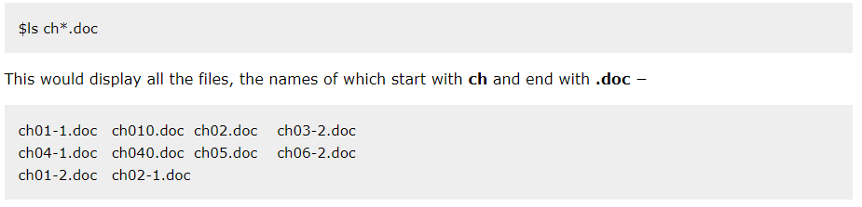
Types of Processes in Linux
In Linux processes can be of two types:
Foreground Processes
Foreground processes are the kinds of processes that require input from the user and are characterized by their interactivity. For instance, a foreground process would be like you are running an Office application on the Linux system.
Depend on the user for input
Also referred to as interactive processes
By default, every process that you start runs in the foreground. It gets its input from the keyboard and sends its output to the screen.
You can see this happen with the ls command. If you wish to list all the files in your current directory, you can use the following command −

Slide 3
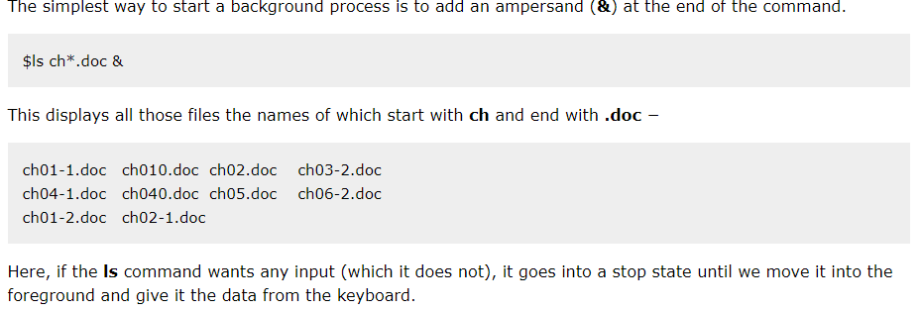
Background Processes
On the other hand, background processes are non-interactive operations carried out in the background and do not call for any participation from the user.
Run independently of the user
Referred to as non-interactive or automatic processes
Antivirus software is an example of a Background Process.
Additionally, processes can be system processes or user processes. System processes are initiated by the kernel, while users initiate User processes.

Slide 4
Process States in Linux
A process in Linux can go through different states after it’s created and before it’s terminated. These states are:
Running: The process is currently executing on the CPU.
Sleeping: The process is waiting for a resource to become available.
Interruptible sleep
Uninterruptible sleep
Stopped: The process has been terminated by a user
Zombie: A process enters the "zombie" state when it has completed its execution but its parent process has not yet read its exit status. At this stage, the process details still have an entry in the process table, but it does not execute any instructions. The zombie process is removed from the process table when its parent process reads its exit status. The process has completed execution but has not yet been cleaned by the system.
Orphan: The parent process of the current process has been terminated.
A process in running state means that it is running or it’s ready to run.
The process is in a sleeping state when it is waiting for a resource to be available.
A process in Interruptible sleep will wakeup to handle signals, whereas a process in Uninterruptible sleep will not.
A process enters a stopped state when it receives a stop signal.
Zombie state is when a process is dead but the entry for the process is still present in the table.

Slide 5
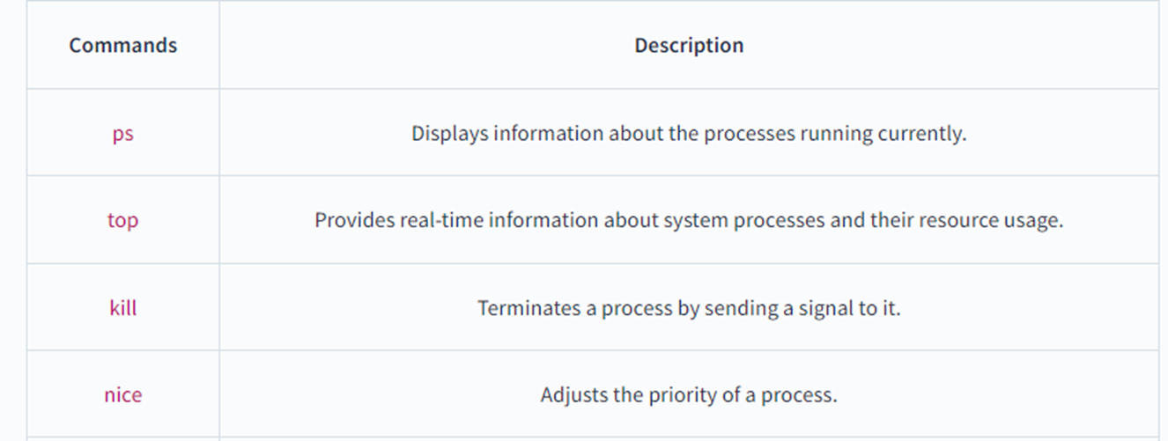
What is Process Management in Linux?
Process management is the task of controlling and monitoring the processes that are running on a Linux system. It involves managing process resources, scheduling processes to run on the CPU, and terminating processes when required.
Commands for Process Management in Linux:
Linux provides several commands for managing processes, which include:

Slide 6
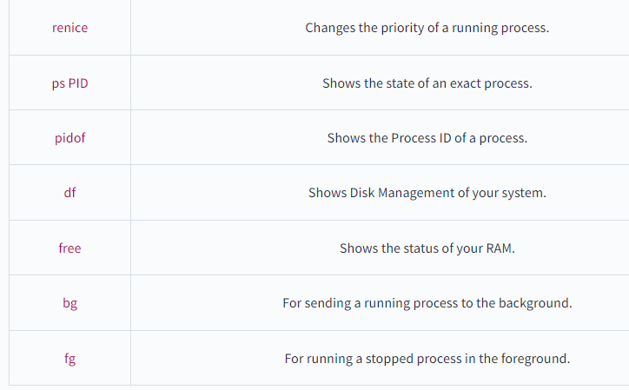

Slide 7
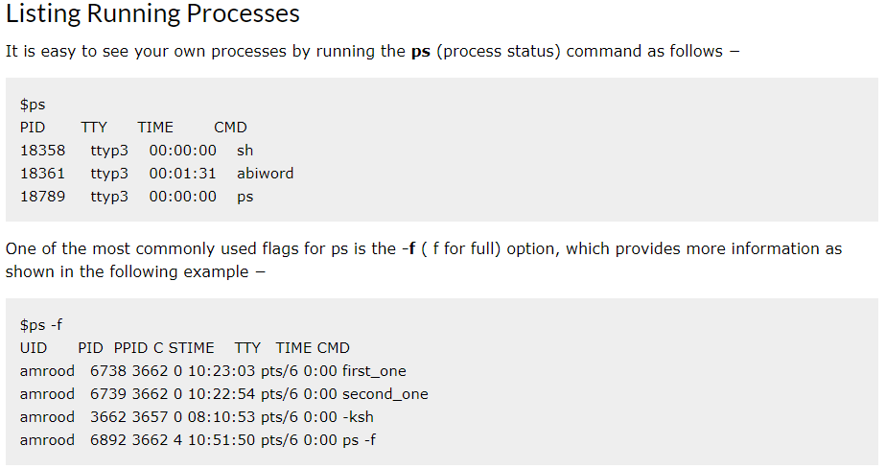

Slide 8
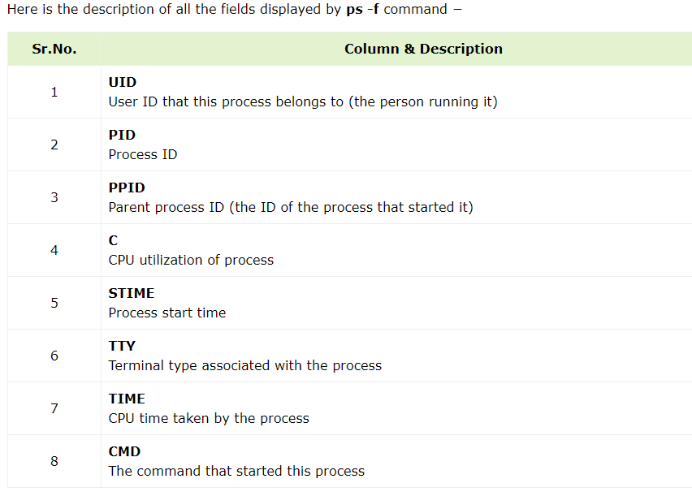

Slide 9
